Slide 1

[The Jews in Berea] were more fair-minded than those in Thessalonica, in that they received the word with all readiness, and searched the Scriptures daily to find out whether these things were so (Acts 17:11).
Beloved, do not believe every spirit, but test the spirits, whether they are of God; because many false prophets have gone out into the world (1 John 4:1).
All Scripture is taken from the New King James Version®. © 1982 by Thomas Nelson, Inc. Used by permission. All rights reserved.
Quality Assessment

Slide 2
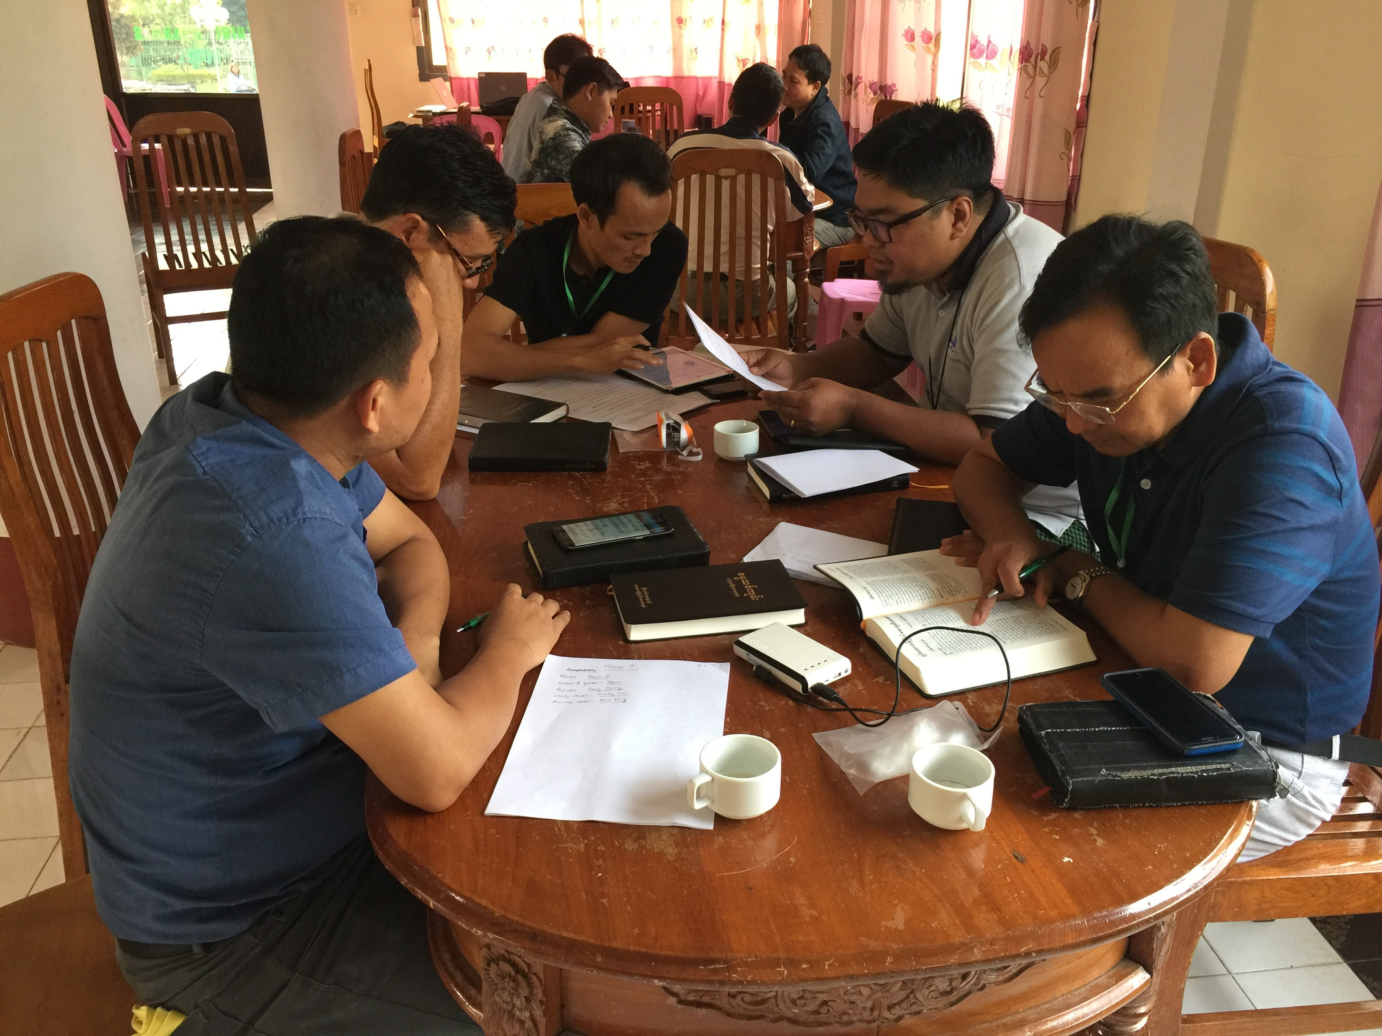
Is it ready?
Keyword Check
Self-edit
Peer-edit

Slide 3
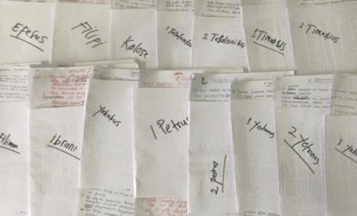



Is it ready?
Keyword Check
Self-edit
Peer-edit
Quality
Naturalness
Standard
Local Church

Slide 4
Quality Assessment Guide
Qualities
________________
________________
________________
Definitions
________________
________________
________________
Questions
________________
________________
Yes or No
________________

Slide 5

Quality Assessment Guide
Qualities
Definitions
Questions
Accurate
Correct style
Clear
Natural
Faithful
Historical
Grammatically correct
Other qualities
________________
________________
________________
________________
________________
________________
________________
________________
________________
________________
________________
________________
________________
________________
________________
________________

Slide 6
Quality Assessment Guide
Quality
Accurate
________________
________________
________________
Definition
The meaning of the translation is the same as the meaning of the source text.
Nothing is added.
Nothing is missing.

Slide 7
Quality Assessment Guide
Quality
Correct Style
________________
Definition
The translation uses the same style as the source text.
• Poetry is expressed as poetry, narrative (story) as narrative, etc.
• Prophecy is not explained.
• Teaching sounds like teaching.
The tone (or emotion) is consistent with the source text.

Slide 8
Quality Assessment Guide
Quality
Clear
________________
Definition
The language and wording are simple and direct.
• When read, its meaning is easy to understand.

Slide 9
Quality Assessment Guide
Quality
Natural
________________
Definition
The translation uses language and style that is common.
• The translation sounds the way people talk or write.

Slide 10
Quality Assessment Guide
Quality
Faithful
________________
Definition
The translation does not favor one opinion over another in theology.
• There is no denominational bias, such as adjusted wording to support a particular baptism practice.

Slide 11
Quality Assessment Guide
Quality
Historical
________________
Definition
The translation maintains the geography, environment, and time of the source text.
• Names of people and places are consistent and correct.
• Plants and animals are accurate to the historical environment of the Scripture.

Slide 12
Quality Assessment Guide
Quality
Grammatically Correct
_____________________________
Definition
The grammar and punctuation of the target language is consistent and
correct.
• Capitalization and punctuation rules are followed.
• Spelling and grammar are correct.

Slide 13

What other qualities are needed in a translation?

Slide 14
What makes a good translation?
List Qualities
Give Objective Definitions
Ask Questions
Yes
No

Slide 15
Try it
Matthew 1:18–25

